Slide 1
Finding funding
Fall 2015

Slide 2
Sources of funding
Government - Federal, State, Local
Foundations - Second-largest source
Corporations, including contracts
Philanthropies

Slide 3
Where to find information
Websites – each foundation or agency
Databases – lists of information
Newsletters – regular publication of articles and information
Personal experience of funded PIs

Slide 4
Federal: NIH home page

Slide 5
Websites: federal (NIH)

Slide 6
Grants.gov

Slide 7
Grants.gov sign-up page

Slide 8
NIH mechanisms
Types of grants
http://grants.nih.gov/grants/funding/funding_program.htm
Factors to consider: what type of data you have, how much time and money you need, and more

Slide 9
Websites: Associations

Slide 10
American Heart Association
http://my.americanheart.org/professional/Research/FundingOpportunities/ForScientists/Programs-by-Funding-Component_UCM_323091_Article.jsp

Slide 11
Web sites: Foundations
Foundation Center: http://foundationcenter.org/
Robert Wood Johnson: http://www.rwjf.org/
Bill and Melinda Gates: http://www.gatesfoundation.org/

Slide 12
ASU resources
University wide:
OKED, including funding.asu.edu
ORSPA
ASU Foundation: Eric Spicer
CONHI: Office for Research and Scholarship (ORS)

Slide 13
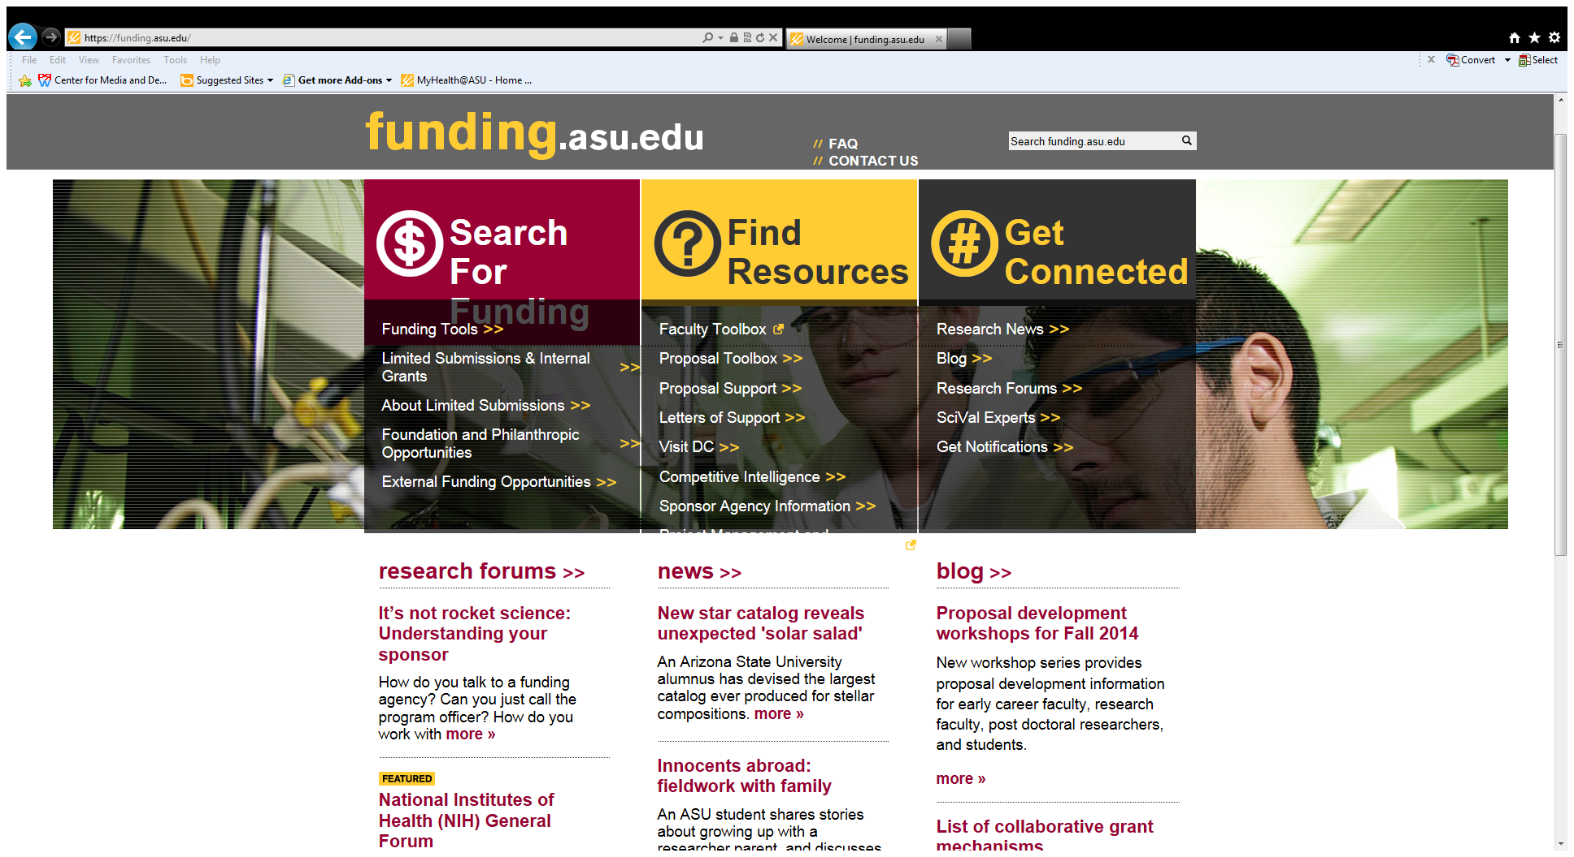
Funding.asu.edu

Slide 14
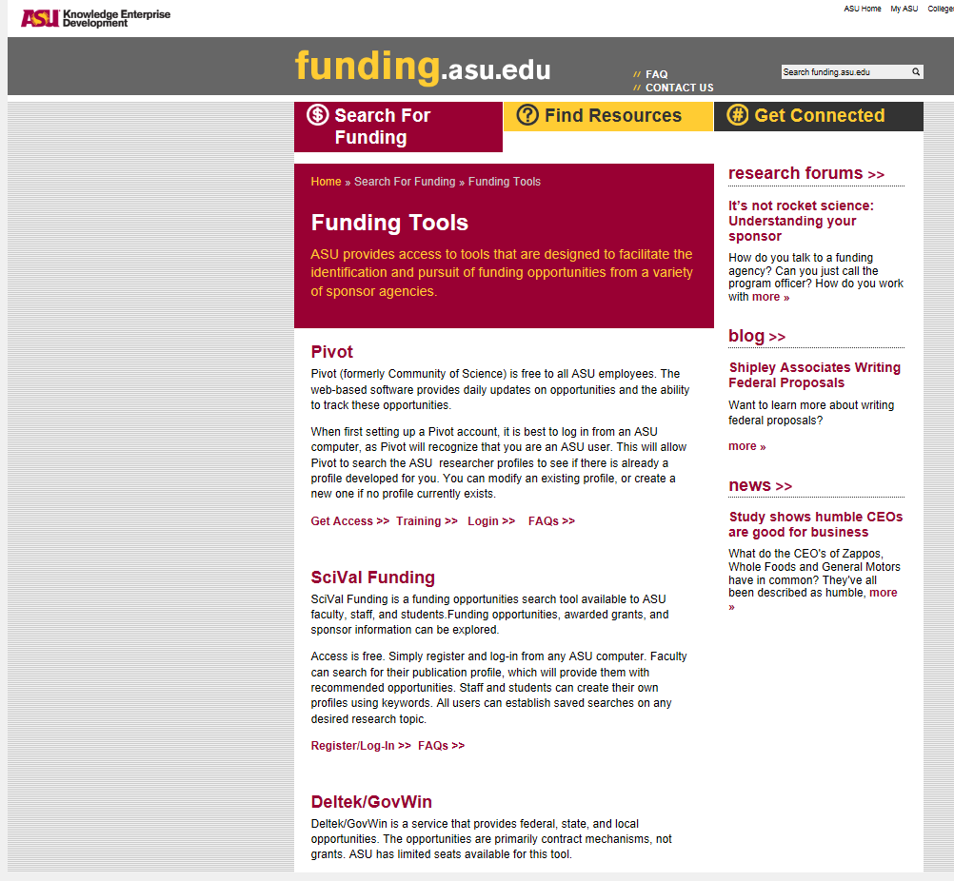
ASU: Databases to access

Slide 15
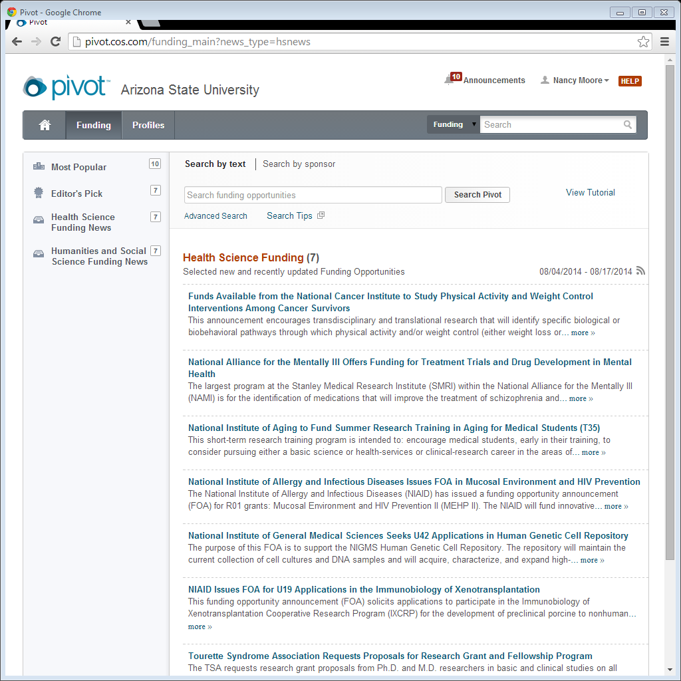
COS/Pivot: Grants

Slide 16
SciVal: Grants
http://scival.com/home
“SciVal Funding”: register via funding.asu.edu
– “contains over 11,000 funding opportunities, data on over two million awarded grants, and information on more than 4,000 sponsors. . . . [and] is accessible to all ASU faculty, staff, and students.”

Slide 17
SciVal: Colleagues in your area
http://www.experts.scival.com/asu/

Slide 18
Lists of lists
Funding.asu.edu: “External Funding Opportunities”: https://funding.asu.edu/search-for-funding/external-funding-opportunities

Slide 19
ASU Limited Submissions
Sponsor allows only one or two grants per institution or unit
At ASU, monitored by OKED
Via funding.asu.edu: internal ASU due date (often very tight and in advance of funder’s date)
Generally: 3-5 page LOI + CVs et al.
OKED picks one+ to go forward

Slide 20
Apply for a Limited Submission
Sign up for RSS feeds to keep on top of announcements – or check funding.asu.edu every week
I try and watch for them and send out emails, but please get on listservs
Notify the ORS right away if you intend to apply for one – don’t wait

Slide 21
Apply for a foundation grant
Eric Spicer – our ASU Foundation contact
At ASU, faculty need first to touch base with internal ASU research/funding support before even contacting a potential foundation funder
So . . . first touch base with the ORS, and they will get Eric into the loop

Slide 22
Prepping for foundations
Work with the ORS and Eric to come up with a plan on emailing, meeting, or otherwise working with a foundation in the preapplication phase
Check with the ORS and Eric for what they need in terms of scheduling, review of drafts, budgeting, and other requirements

Slide 23
Homework
Finding funding includes picking the right funder and mechanism
Think about setting aside time each day to look for funding and reading websites of the funders who offer grants

Slide 24
More homework
Find out who has been funded
Helps you determine if your interests match the funder’s interests: e.g., NIDDK or NIA? Do they fund behavioral studies or only bench science?
Lets you learn if a funder has already funded a project similar to yours
Could help you find collaborators

Slide 25
Where to find out who’s been funded
• NIH RePORT (Research Portfolio Online Reporting Tools): http://www.report.nih.gov/
• NSF: http://www.nsf.gov/awardsearch/
• American Cancer Society: http://www.cancer.org/research/acsresearchupdates/more/fast-facts-about-american-cancer-society-research

Slide 26
Federal RePORTER
A single web portal that allows researcher to search federal-funded science projects across multiple agencies
Announced in “Rock Talk” a year ago
http://federalreporter.nih.gov/

Slide 27
Resources sometimes overlooked
• Newsletters and press releases
Foundation Center
NIH: http://nih.gov/news/releases.htm
• Blogs
“Rock Talk”: http://nexus.od.nih.gov/all/category/blog/
• Acknowledgments in papers of interest

Slide 28
Read these too
Annual Reports & GuideStar
Who they funded, where they funded, how much they awarded each project, confirmation of its priorities, et al.
E.g., Kresge: http://kresge.org/about-us/annual-report
Budget Requests
For trends and availability of funding – e.g., NSF:
http://www.nsf.gov/about/performance/

Slide 29
Many writing resources available
• OKED – esp. funding.asu.edu
Proposal writing clinic
Workshops – e.g., fs3: faculty and research admin but have wait-listed students
“Find resources” tab
Faculty toolbox – advice, tips, lots of information
TRIPS https://funding.asu.edu/opportunities/travel-research-investigators-potential-sponsors-trips

Slide 30
Other worthwhile venues
• Workshops
NIH Regional Seminars
http://grants.nih.gov/grants/seminars.htm - in mid October in San Diego – can still register
Beware of private workshops

Slide 31
Choosing a funder
Thoroughly read guidelines, calls for proposals, or other documentation a funder publishes
Be sure you are in synch with what the organization wants to do
If your project is not consistent with its stated priorities, you will likely have a hard time convincing them to fund you

Slide 32
Before, during, and after
Talk to your colleagues for advice on funders and any administrative issues that might arise
The ORS
Other faculty in CHS or CONHI
ASU Foundation
Other faculty in the university or beyond
Program officers

Slide 33
Factors to consider, 1
How long you need to do your work
How much money you need to do your work
Whether you can fund small pieces of a larger long-term project: what do you need to know to progress?

Slide 34
Factors to consider, 2
What experience and prior work (e.g., grants, publications, or field experience) you must have to be competitive
Who else could be on your team and related issues: e.g., does the budget allow many people to join you?

Slide 35
Factors to consider, 3
What is the likelihood of funding (but do not necessarily let low odds stop you): e.g., what % of submissions do the funders award? How many per year?
Have you signed up for any and all relevant listservs and are reading them all?

Slide 36
Thank you!
Questions?

