Slide 1
Identifying Gaps in the Literature
Janice Hermer & Kevin Pardon
ASU Library

Slide 2
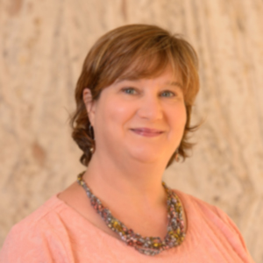
Who are we?
Your Health Sciences Librarians!
Janice.Hermer@asu.edu 602-496-0683 Kevin.Pardon@asu.edu 602-496-0487
Notes:
We’ll talk more about some of the services we can offer you later but in case you don’t know us we are your health sciences librarians.

Slide 3
Purpose
Identifying Gaps in the Research allows you to:
Consolidate known information
Informs your research decisions
Argument for funding

Slide 4
Background/Starting Out:
Do you have a research question?
What do we know about this topic?
Are you applying for a grant?
Notes:
If youre doing original research, lets you know if there is a need for this. Do you need to refine your question?
Do you want to ensure your question is unique?

Slide 5
Methods to Identifying Gaps
Environmental Scan
Rapid Review
Systematic Review
Scoping Review
Notes:
Not limited to these 4 only but 3 of the 4 are great for starting out, easier to do. Etc.

Slide 6
Environmental Scan
...is the art of systematically exploring and taking note of what is the external environment of your organization in part to better understand the nature of trends and deep drivers of change...ES are used to provide decision-makers with knowledge about current social, economic, technological and political contexts, and to identify any potential short- and long-term shifts…
Source: http://hlwiki.slais.ubc.ca/index.php/Environmental_scans

Slide 7
Rapid Review
...is a research methodology that uses shorter timeframes than for other evidence-based summaries. It provides a timely and valid view of evidence but sacrifices rigour. As such, RRs are both review and assessment, and respond to urgent clinical and public health-related questions. They aim to provide robust analyses of easily-retrievable evidence in less than six weeks...typically requiring fewer resources and funding…
Source: http://hlwiki.slais.ubc.ca/index.php/Rapid_reviews
Notes:
Zika virus example, FAST, not comprehensive, but are publishable, especially if new topic.

Slide 8
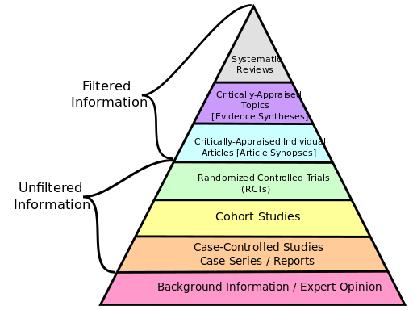
Systematic Review
...is an investigation of a clearly-formulated question that uses methodical and explicit steps to identify, select, and critically appraise relevant research, and to collect and analyze data from any appropriate studies that may be found.
Source: http://hlwiki.slais.ubc.ca/index.php/Systematic_review

Slide 9
Systematic Review: Process
A series of searches for papers or studies
A comparison of important features in each study against a list of inclusion and/or exclusion criteria
A detailed critical appraisal of each study for risk of bias and potential confounding factors
Detailed methodology must be documented for publication
Notes:
Removed this bullet point FYI if you want to say it still: Statistical methods (meta-analysis) may or may not be applied to analyze and summarize the results
Additionally, must have a team of individuals,

Slide 10
Scoping Review
...are exploratory projects that systematically map the literature on a topic, identifying key concepts, theories and sources of evidence. SR aim to address broader, more complex, and exploratory research questions…[as opposed to] systematic reviews which are designed to answer precisely defined, narrow questions…
Source: http://hlwiki.slais.ubc.ca/index.php/Scoping_reviews
Notes:
Exploratory, broader topics.

Slide 11
Scoping Review
Scoping Reviews are commonly used to better understand phenomena and to evaluate where research on the topic has or has not been completed. Scoping Reviews are often a first step in conducting a Systematic Review…
Source: http://hlwiki.slais.ubc.ca/index.php/Scoping_reviews
Notes:
Exploratory, broader topics.

Slide 12
Scoping Review vs Systematic Review
Study question Often Broad Focused
Search Strategy Systematic & transparent Systematic & transparent
Inclusion/exclusion Flexible Defined a priori
criteria
Study appraisal None/minor Yes
Synthesis Typically qualitative Often quantitative
Source: http://hlwiki.slais.ubc.ca/index.php/Scoping_reviews

Slide 13
Identify Research Interests
Developing a clear question
Notes:
Can alter question as you go.

Slide 14
Planning your Review
Search Strategy (What databases will you search, keywords, subject terms, limits, etc.)
Inclusion Criteria & Exclusion Criteria
Documentation of process

Slide 15
Planning your Review
Test Searches/background searches to inform your question and search strategy
Refine/alter question?

Slide 16
Conducting your Search
Search databases
Look for grey literature
Hand searching
Document everything!
Notes:
We’re not going to tell you how to search because….sherlock holmes image...

Slide 17
Analyzing your Search Results
Refer back to your criteria
Discover trends
Look for gaps
Follow Up Searches
Notes:
What did you find? What didn’t you find? If you find a systematic cochrane review it’s covered. There was enough to even do a review. How many articles met your criteria? Did you find anything? Use the gaps you find to justify your research, grants, etc. If there’s a ton of information maybe you do a systematic review instead of new original research.

Slide 18
Additional Strategies/Tools
Set up Alerts
Sign up for ORCID ID
RefWorks
Notes:
Oricd ID source: http://library.cmu.edu/sites/drupal-live.library.cmu.edu/files/Orcid.png.

Slide 19
What’s Next?
Organize information
Draft paper
Apply for grant(s)
Publish!
Plan the next round of research
Notes:
Always act as if you are going to publish even if you don’t plan to...ya never know. And good practice because you are likely to be more organized, have all the information in case you are questioned by the grant funding agency, or others. After you’ve completed the scoping review you should be able to identify gaps in the research literature. If you haven’t identified any gaps or found several systematice reviews or other in-depth comprehensive reviews on your topic then that might tell you.
- Shown to funders that you have done your background research and identified important gaps.
- Will help to inform your research question. Tweaks, changes, etc. broader.
-Used for writing lesson plan in relevant classes as example

Slide 20
Selecting a Journal
Notes:
Impace image source: http://blogs.lib.ucdavis.edu/schcomm/files/2013/10/main.jpg
I know a lot of faculty have to publish simply as part of their job requirements, but you also want to think about, what you are trying to accomplish, what difference are you trying to make, what goals do you have related to your publishing.
Check Impact Factor in Scopus and Web of Science.
Think about your intended audience - do you want your article to be read by other nurses? Doctors? Policy makers? Sometimes, I recommend publishing outside of a traditional nursing journal depending on the topic as in many cases you are preaching to the choir.

Slide 21
Selecting a Journal
Talk to your Colleagues & Peers
Locate articles on your topic or similar topic and see what journals they are published in
Look at previously published articles from journals you are considering

Slide 22
Selecting a Journal
Avoid Predatory Publishers
Notes:
Talk to your librarian if you have concerns or questions about a specific journal
Watch out for unsolicited journal messages
Image source: http://www.lib.sfu.ca/system/files/26696/Shark2.jpg

Slide 23
Our Services
Teach advanced search skills
Advise on journal selection, scholarly communication, copyright, impact factor, & more
Consult on search strategy
Consult on information organization and planning stages

Slide 24
Questions? Discussion?

Slide 25
Sample articles
Environmental Scan
Rapid Review
Scoping Review
Systematic Review
Grant, M. J., & Booth, A. (2009). A typology of reviews: An analysis of 14 review types and associated methodologies. Health Information & Libraries Journal, 26(2), 91-108. doi:10.1111/j.1471-1842.2009.00848.x

